Slide 1
Object Detection
Jia-Bin Huang
Virginia Tech
ECE 6554 Advanced Computer Vision

Slide 2
Today’s class
Review on transfer learning
Discussion of the paper
  Rich feature hierarchies for accurate object detection and semantic segmentation. R. Girshick, J. Donahue, T. Darrell, J. Malik. CVPR 2014
  “For” lead: Subhashree
  “Against” lead: Yousi
Overview of categorical object detection
Recent advances

Slide 3
Review: transfer learning
New dataset is small and similar to original dataset.
  train a linear classifier on the CNN codes
New dataset is large and similar to the original dataset
  fine-tune through the full network
New dataset is small but very different from the original dataset
  SVM classifier from activations somewhere earlier in the network
New dataset is large and very different from the original dataset
  fine-tune through the entire network

Slide 4
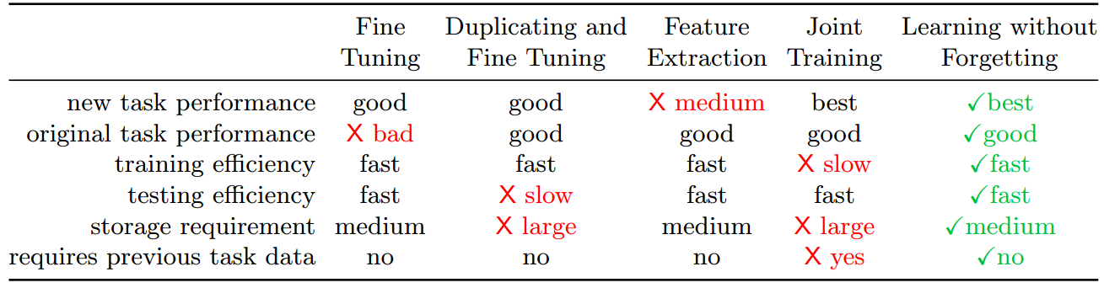
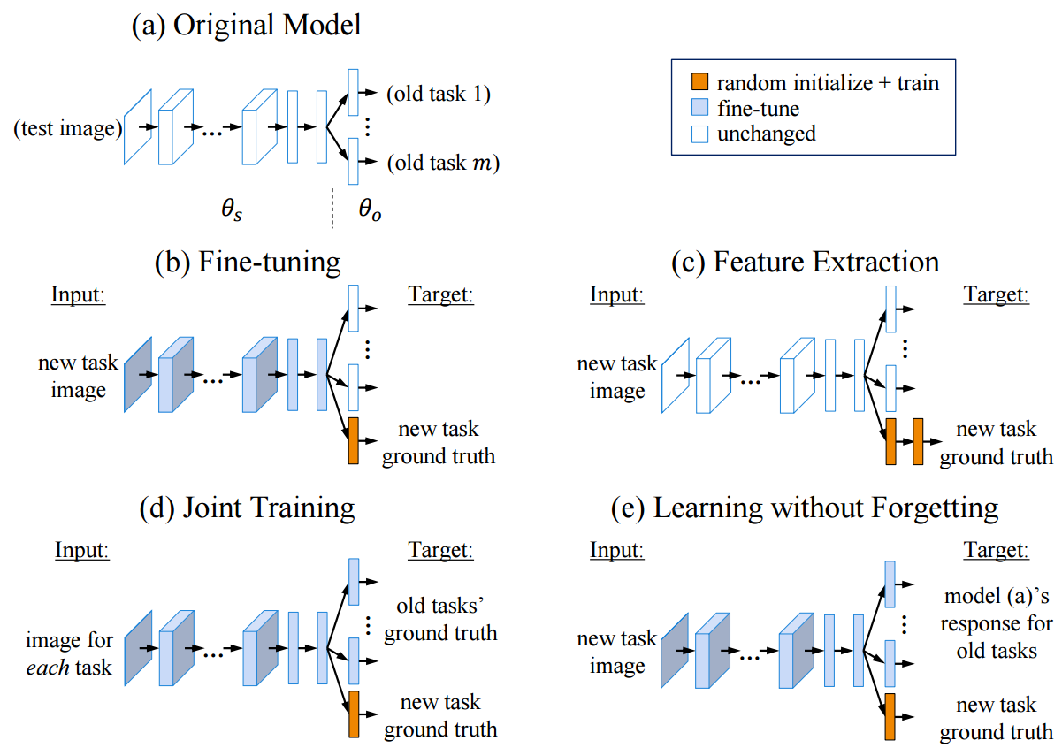
Learning without forgetting, ECCV 2016

Slide 5
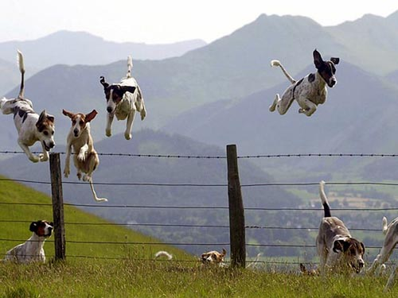
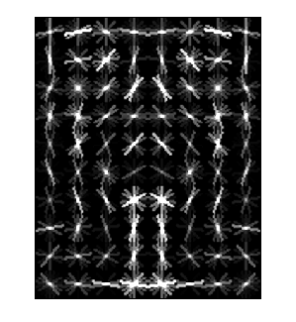
Object Category Detection
Focus on object search: “Where is it?”
Build templates that quickly differentiate object patch from background patch
Dog Model
…
Object or
Non-Object?

Slide 6
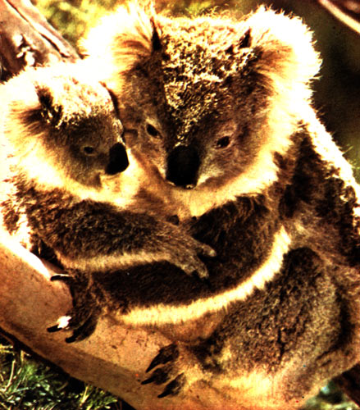

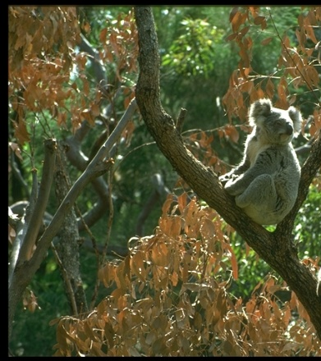

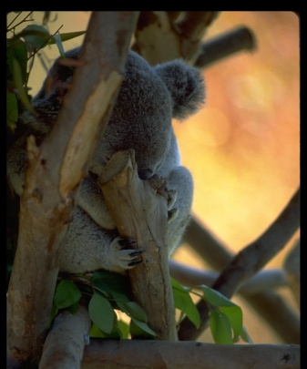

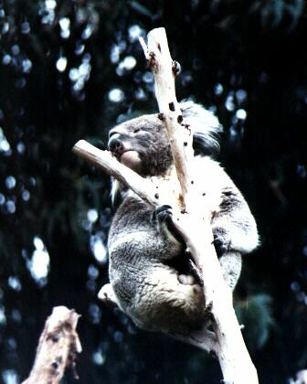
Challenges in modeling the object class
Illumination
Object pose
Clutter
Occlusions
Intra-class appearance
Viewpoint
Slide from K. Grauman, B. Leibe

Slide 7
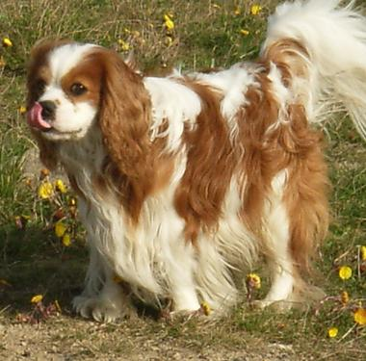
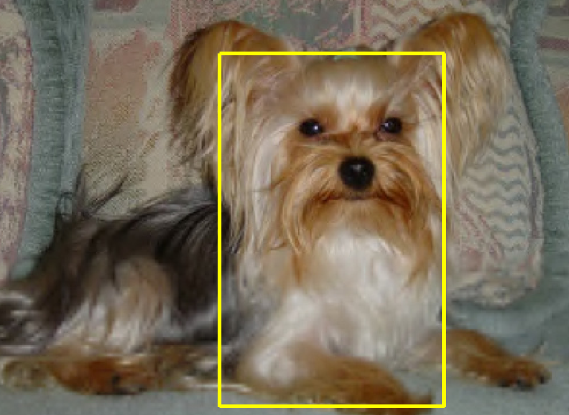
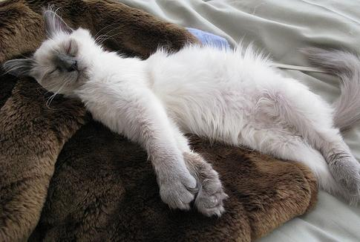
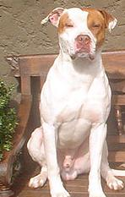


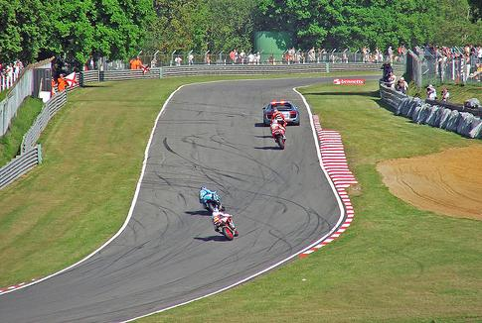

Challenges in modeling the non-object class
True Detections
Bad Localization
Confused with Similar Object
Confused with Dissimilar Objects
Misc. Background

Slide 8
General Process of Object Recognition
Specify Object Model
What are the object parameters?
Generate Hypotheses
Score Hypotheses
Resolve Detections

Slide 9
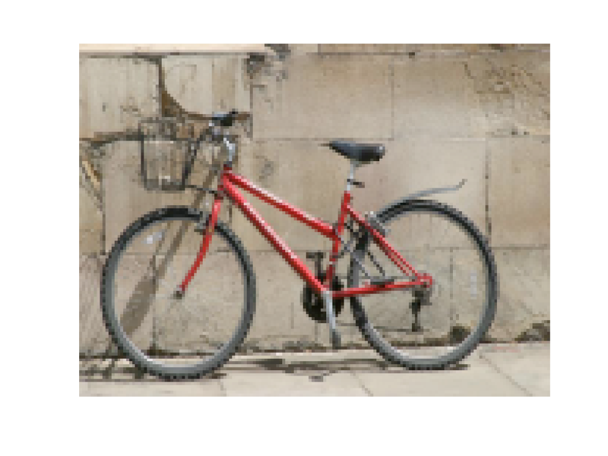
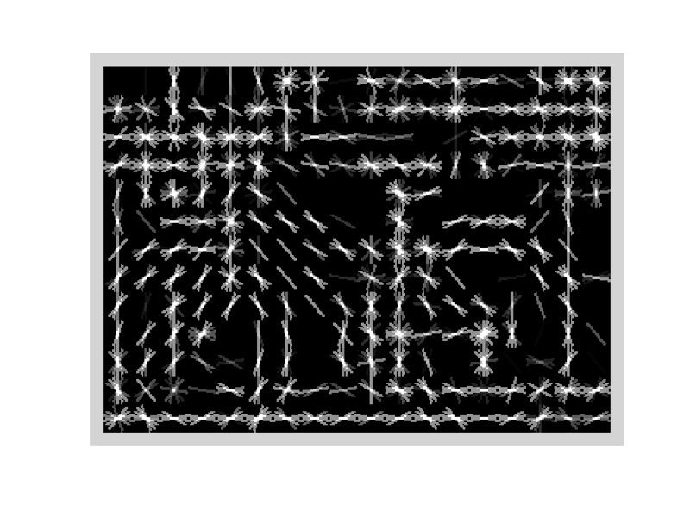
Specifying an object model
Statistical Template in Bounding Box
  Object is some (x,y,w,h) in image
  Features defined wrt bounding box coordinates
Image
Template Visualization
Images from Felzenszwalb

Slide 10
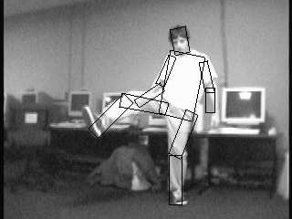

Specifying an object model
2. Articulated parts model
  Object is configuration of parts
  Each part is detectable
Images from Felzenszwalb

Slide 11

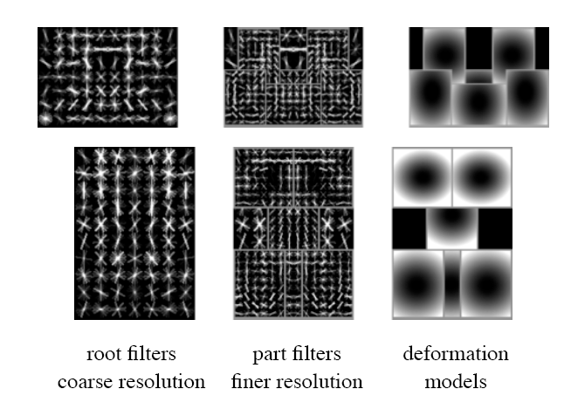
Specifying an object model
3. Hybrid template/parts model
Detections
Template Visualization
Felzenszwalb et al. 2008

Slide 12
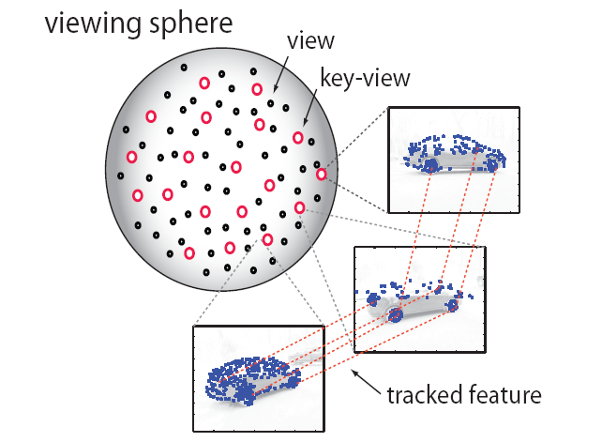
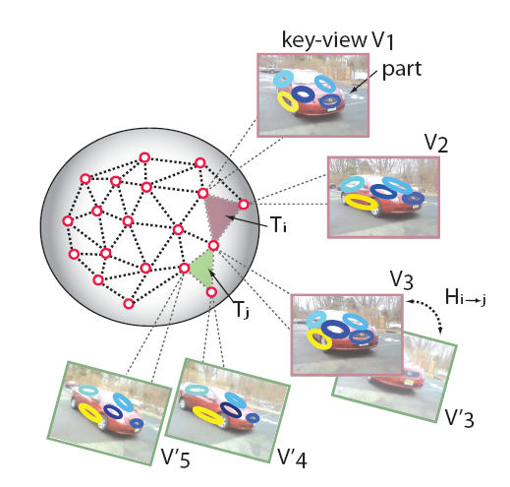
Specifying an object model
3D-ish model
Object is collection of 3D planar patches under affine transformation

Slide 13
General Process of Object Recognition
Specify Object Model
Generate Hypotheses
Propose an alignment of the model to the image
Score Hypotheses
Resolve Detections

Slide 14

Generating hypotheses
Sliding window
  Test patch at each location and scale

Slide 15
Generating hypotheses
Sliding window
  Test patch at each location and scale

Slide 16
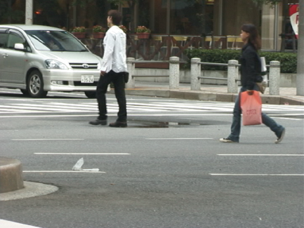
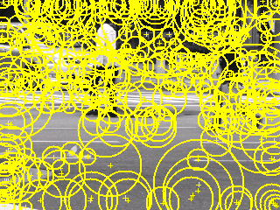
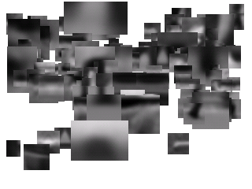
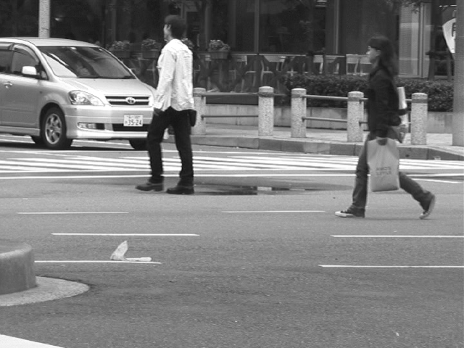
Generating hypotheses
2. Voting from patches/keypoints
Matched Codebook
Entries
Probabilistic
Voting
Interest Points
y
s
3D Voting Space
(continuous)
x
ISM model by Leibe et al.

Slide 17
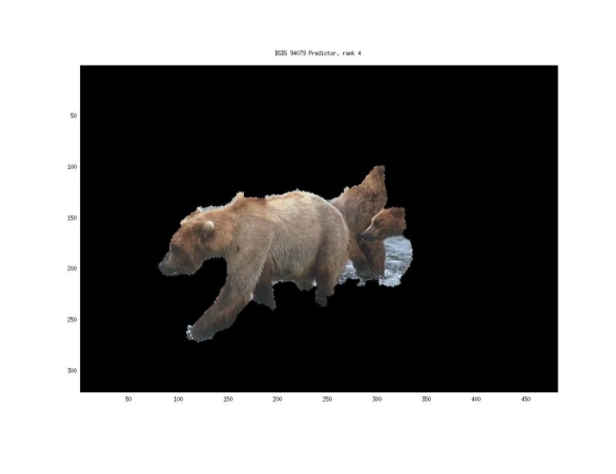
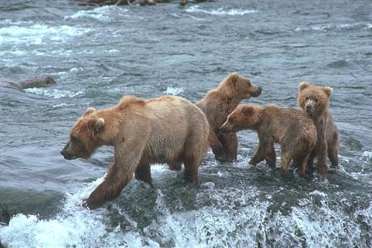
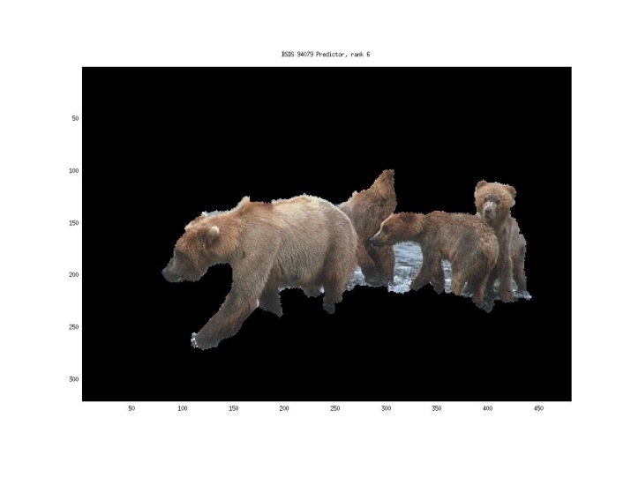
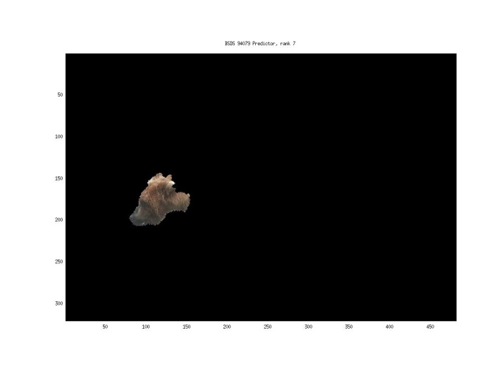
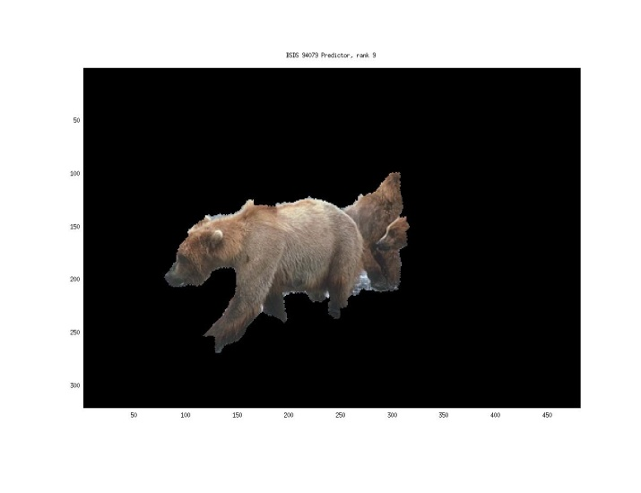
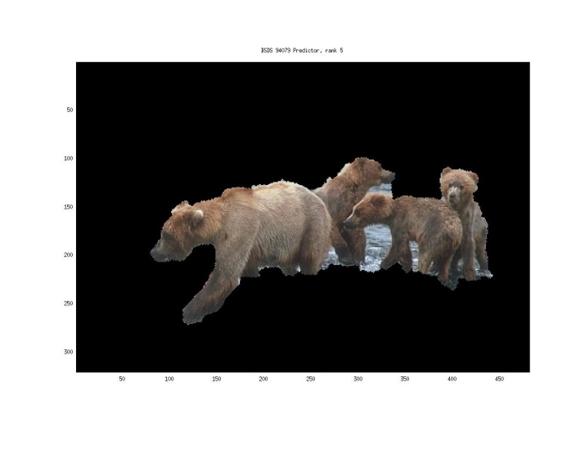
Generating hypotheses
3. Region-based proposal
Endres Hoiem 2010

Slide 18
General Process of Object Recognition
Specify Object Model
Generate Hypotheses
Mainly-gradient based or CNN features, usually based on summary representation, many classifiers
Score Hypotheses
Resolve Detections

Slide 19
General Process of Object Recognition
Specify Object Model
Generate Hypotheses
Score Hypotheses
Resolve Detections
Rescore each proposed object based on whole set

Slide 20
Resolving detection scores
Non-max suppression
Score = 0.8
Score = 0.8
Score = 0.1

Slide 21
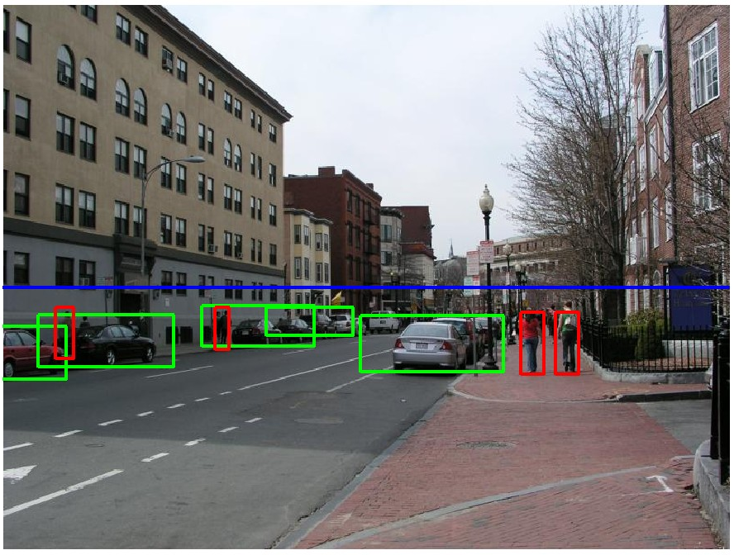
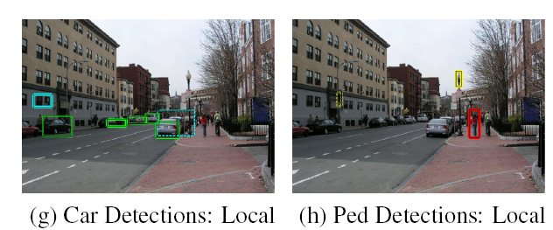
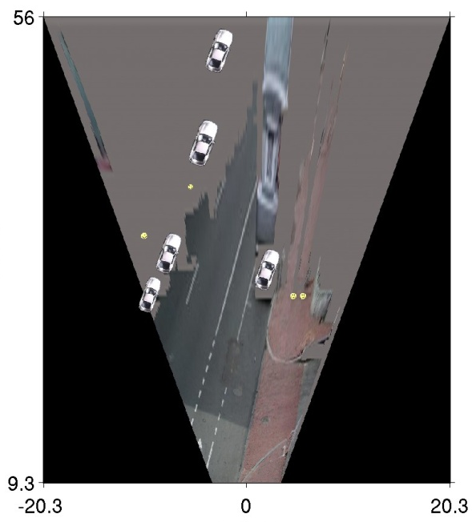
Resolving detection scores
2. Context/reasoning
meters
Hoiem et al. 2006
meters

Slide 22
Object category detection in computer vision
Goal: detect all pedestrians, cars, monkeys, etc in image

Slide 23
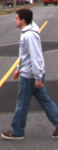
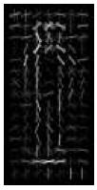
Basic Steps of Category Detection
Align
  E.g., choose position, scale orientation
  How to make this tractable?
Compare
  Compute similarity to an example object or to a summary representation
  Which differences in appearance are important?
Aligned
Possible Objects
Exemplar
Summary

Slide 24
Sliding window: a simple alignment solution
…
…

Slide 25

Each window is separately classified

Slide 26
Statistical Template
Object model = sum of scores of features at fixed positions
?
+3
+2
-2
-1
-2.5
= -0.5
> 7.5
Non-object
?
+4
+1
+0.5
+3
+0.5
= 10.5
> 7.5
Object

Slide 27
R-CNN (Girshick et al. CVPR 2014)
Replace sliding windows with “selective search” region proposals (Uijilings et al. IJCV 2013)
Extract rectangles around regions and resize to 227x227
Extract features with fine-tuned CNN (that was initialized with network trained on ImageNet before training)
Classify last layer of network features with SVM
http://arxiv.org/pdf/1311.2524.pdf

Slide 28
Sliding window vs. region proposals
Sliding window
Region proposals
Comprehensive search over position, scale (sometimes aspect, though expensive)
Typically 100K candidates
Simple
Speed boost through convolution often possible
Repeatable
Even with many candidates, may not be a good fit to object
Search over regions guided by image contours/patterns with varying aspect/size
Typically 2-10K candidates
Random (not repeatable)
Requires a preprocess (currently 1-5s)
Often requires resizing patch to fit fixed size
More likely to provide candidates with very good object fit

Slide 29
HOG Template
Statistical Template Matching
HOG: Dalal-Triggs 2005

Slide 30
Deformable Parts Model (v1-v5)
HOG Template
Better Models of Complex Categories
HOG: Dalal-Triggs 2005 DPM: Felzenszwalb et al. 2008-2012

Slide 31
R-CNN
Regionlets
Deformable Parts Model (v1-v5)
HOG Template
Key Advance: Learn effective features from massive amounts of labeled data and
adapt to new tasks with less data
Better Features
HOG: Dalal-Triggs 2005 DPM: Felzenszwalb et al. 2008-2012 Regionlets: Wang et al. 2013 R-CNN: Girshick et al. 2014

Slide 32

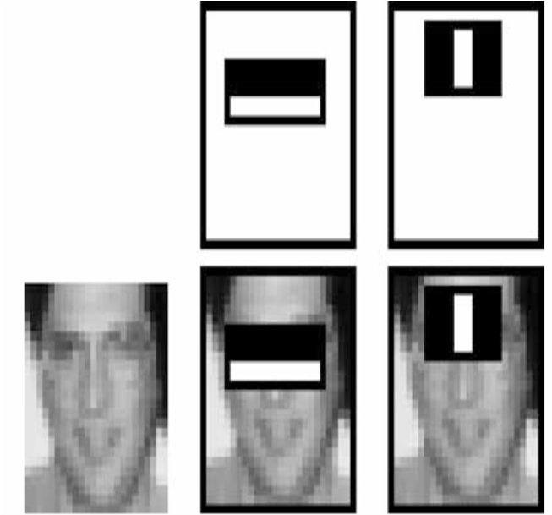
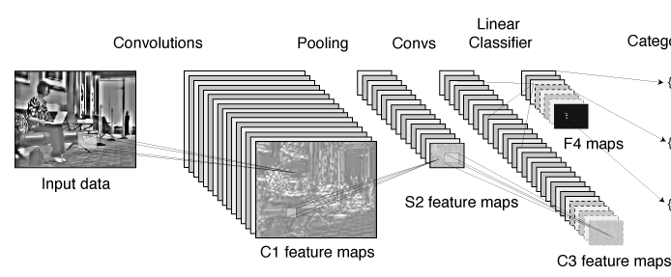
Summary: templates
Propose Window
Extract Features
Classify
Post-process
SVM
Boosted stubs
Neural network
Non-max suppression
Segment or refine localization
HOG
Sliding window: scan image pyramid
Fast randomized features
Region proposals: edge/region-based, resize to fixed window
CNN features

Slide 33
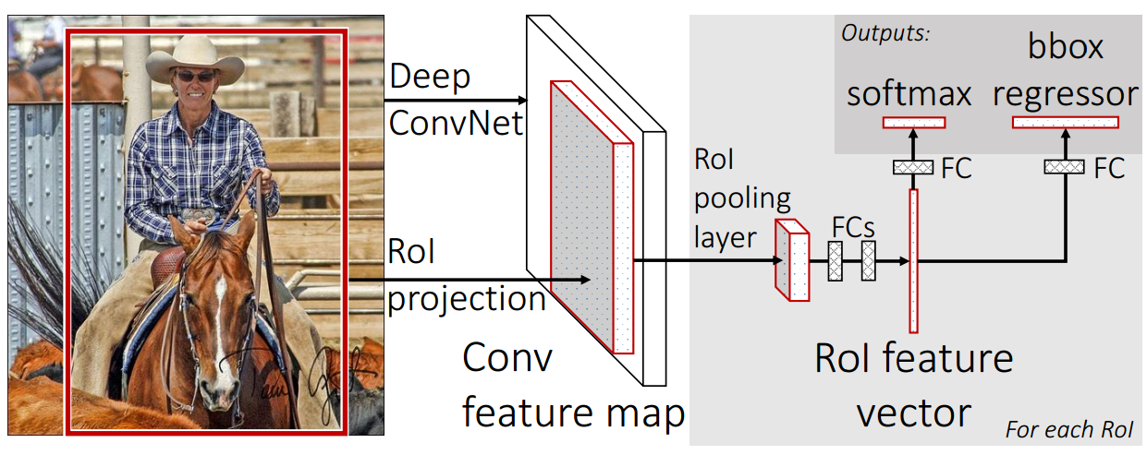
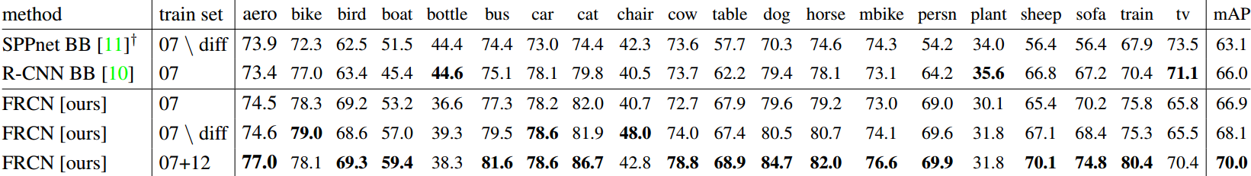
Fast RCNN, ICCV 2015

Slide 34
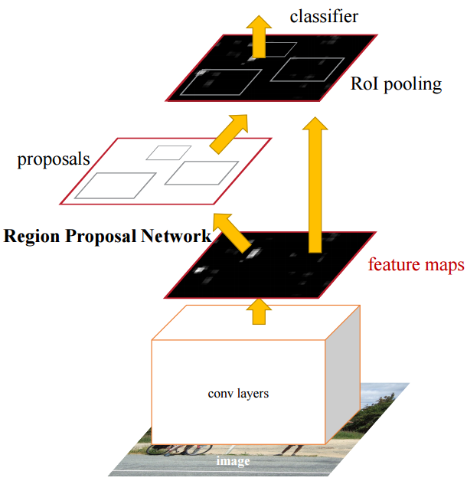
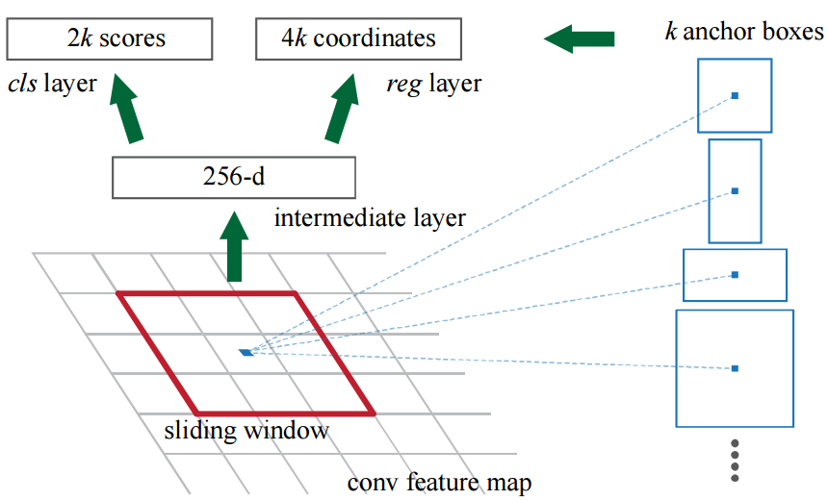
Faster R-CNN: Towards Real-Time Object Detection with Region Proposal Networks, NIPS 2015

Slide 35
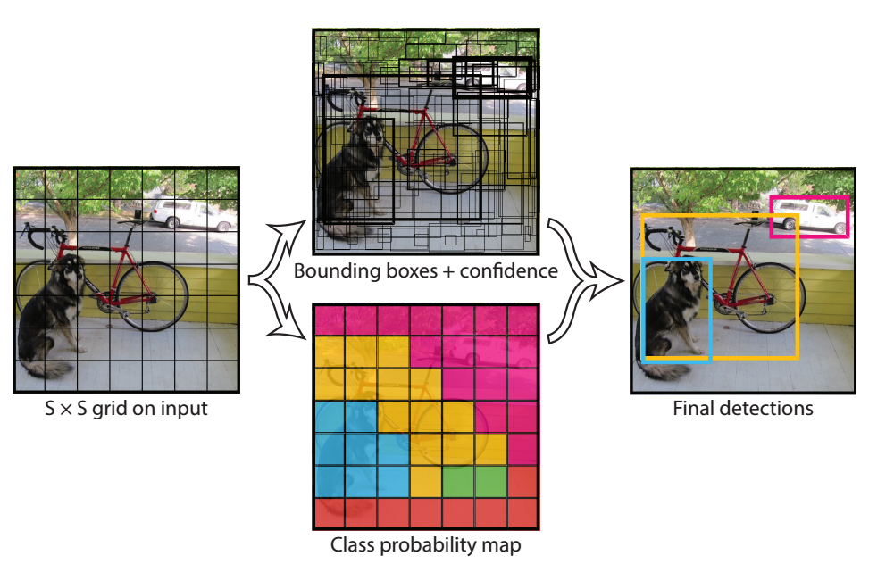
YOLO: Real-Time Object Detection, CVPR 2016

Slide 36
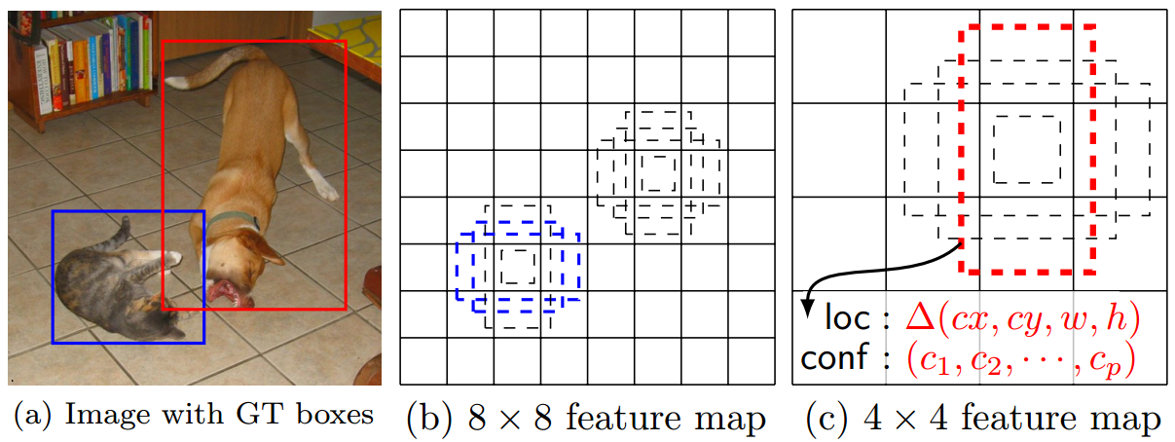
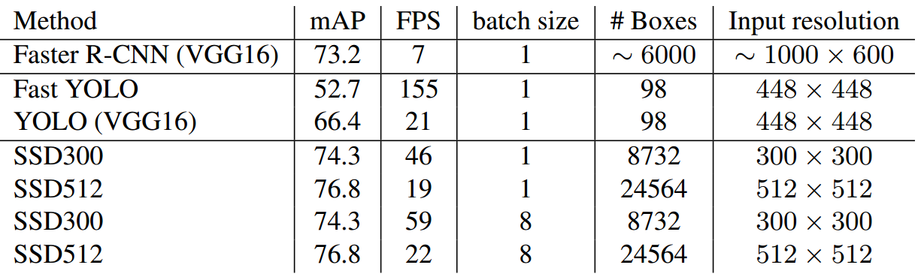
SSD: Single Shot MultiBox Detector, ECCV 2016

Slide 37
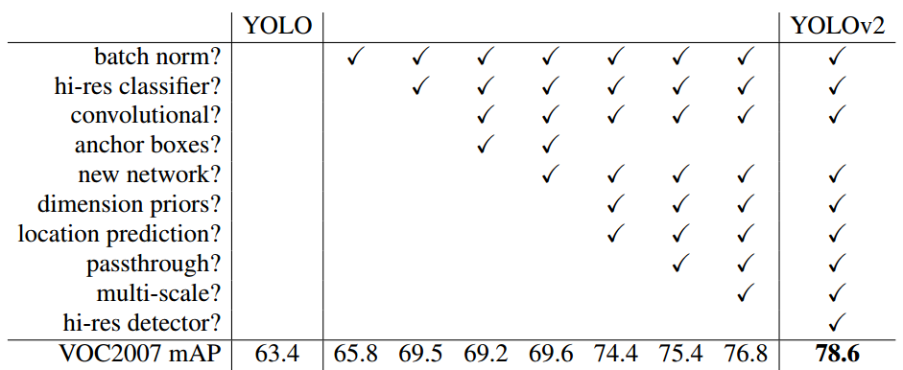
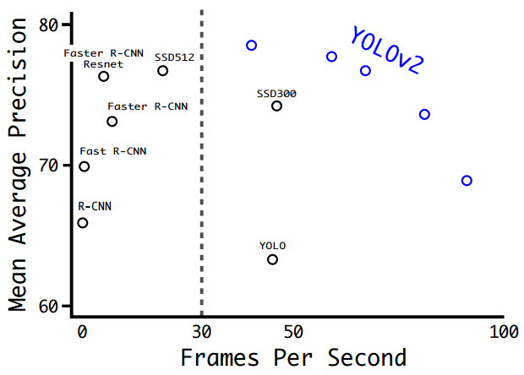
YOLO9000: Better, Faster, Stronger, arXiv 2016

Slide 38

YOLO9000: Better, Faster, Stronger, arXiv 2016

Slide 39
Things to remember
Specify Object Model
  Statistical template
Generate Hypotheses
  Sliding windows
  Object proposal algorithms
  Region proposal network
Score Hypotheses
  CNN
Resolve Detections
  Non-maximum suppression

